Slide 1
Timeline
0m
20m
40m
Deep Learning
Live Demo
Self-driving
Screen PUB/SUB
Trip Basics
Introduction
Car State PUB/SUB
Train Model
ZMQ Basics
Summary
GTA

Slide 2

@rudigrobler v1.0.6
SELF-DRIVING cars using GTA and DEEP LEARNING
Notes:
Who am I?
Why am I here?
NB: Limited time (Only 40 minutes)
What will we be doing?

Slide 3

@rudigrobler v1.0.6
SELF-DRIVING cars using GTA and DEEP LEARNING
Notes:
The first topic we must discuss a little bit more in depth is self-driving

Slide 4
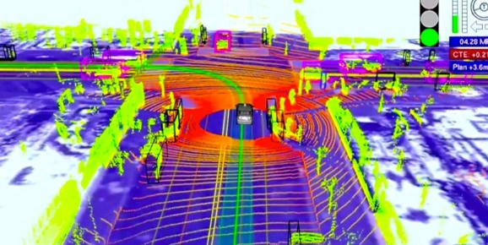
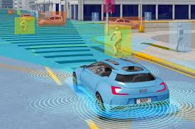
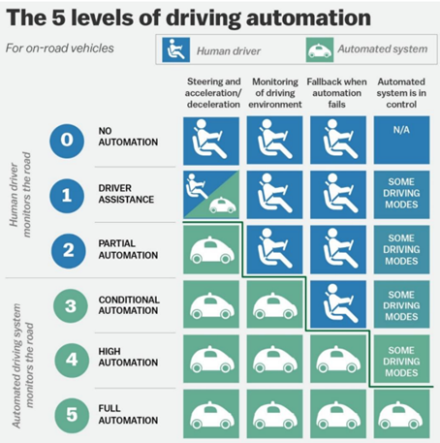
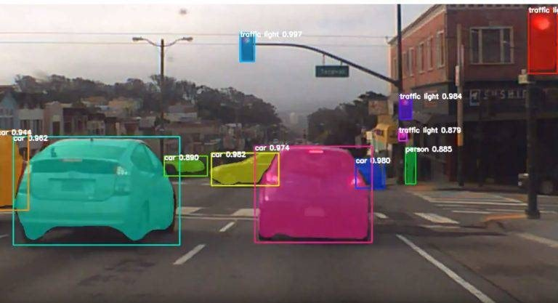

Self-driving
It’s hard, but possible
Many approaches, and techniques
Companies, People
“A self-driving car, that is, a ground vehicle that is capable of sensing its environment and moving safely with little or no human input.”
~ Wikipedia
What is Self-driving?
Notes:
Self-driving was initially selected just as a background to try out some machine learning and AI concepts, but it turned out that self-driving is really hard. Harder than I initially thought, and I do not think we are their yet.
Theirs a bunch of companies doing interesting work in this companies and thy use a variety of companies and approaches to try and solve this problem.

Slide 5



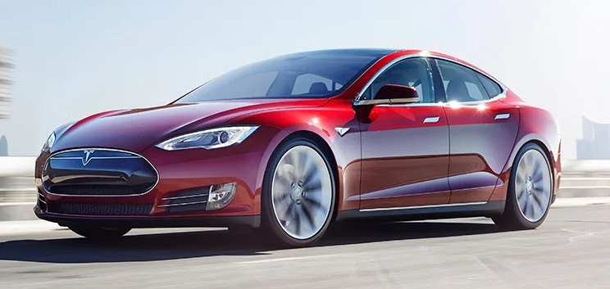
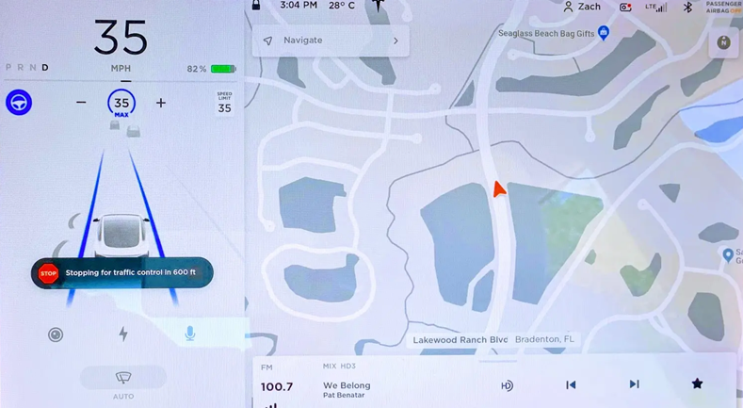
Self-driving
Tesla
Autopilot
comma.ai
openpilot
Waymo
Notes:
The first and probably the best-known company is Tesla with Autopilot. Thy are in a lot of ways the Apple of self-driving by controlling everything, from the car, its sensors and the software, end to end. Their focus is localizing the scene around the car and then using this to plan and control the movement of the car.

Slide 6


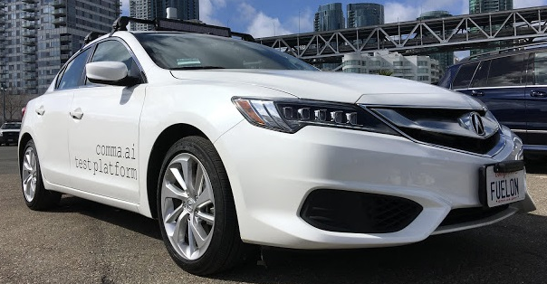
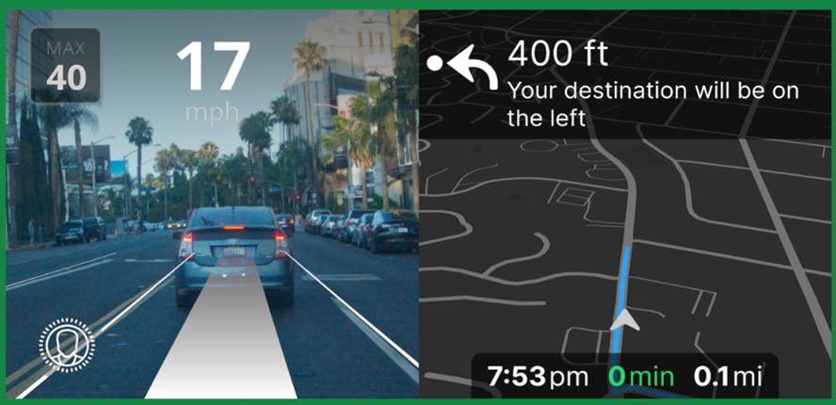
Self-driving
Tesla
Autopilot
comma.ai
openpilot
Waymo
Notes:
On the other end of the spectrum, we have comma.ai with openpilot. If tesla is the apple, then comma.ai is the android of self-driving. Thy use open-source software called openpilot and then thy sell a device like the one showed here (called comma two or now three), for +/- $1000. This then connects to the car via a can-bus harness. Thy support almost 50 different models of the latest cars released in the last 5 years.
Since thy do not control all the car sensors, thy heavily really on vision to control their cars end-to-end. Thy collect thousands of hours of driving and train their models to not just understand the scene, but also how drivers typically drive. Thy would stay in lane lines not just because thy can see it, but because most people stay in lane line. The same for stop streets, not just because its red or the word stop on the ground, but because most people stop!

Slide 7

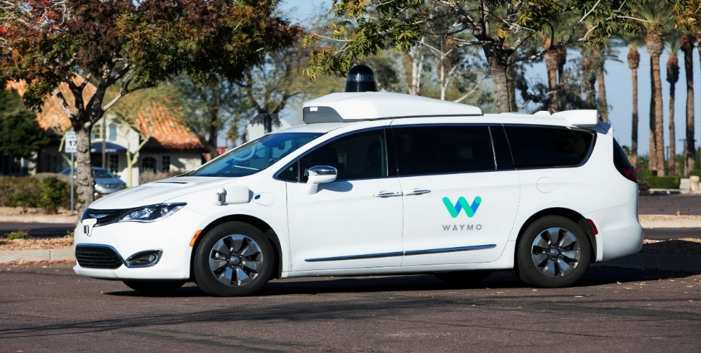
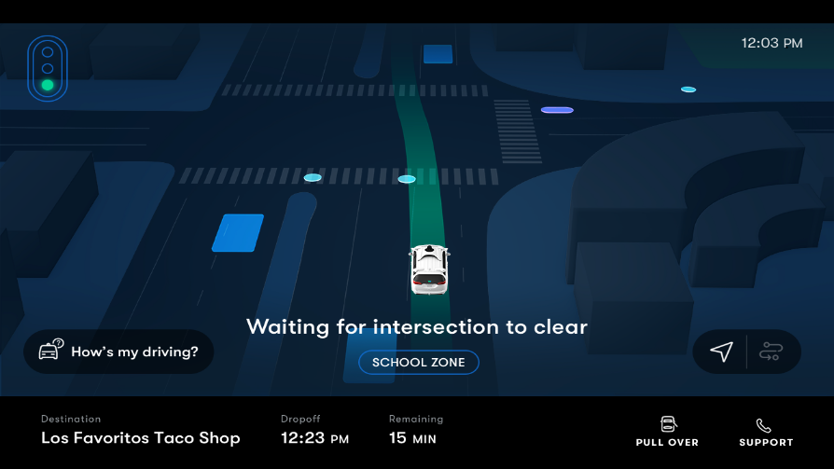
Self-driving
Tesla
Autopilot
comma.ai
openpilot
Waymo
Notes:
The last company we will be looking at is waymo. Ironically thy were owned by Google. Waymo can drive fully automated and works like uber where you can simple order a waymo ride, but they have 2 big distinctions, the first is thy heavily rely on their environment. Which means thy only work in certain cities. And secondly thy have very specific sensors on their vehicles, like the big hood on top of the vehicle in this picture. Thy heavily use lidar to detect objects around them!

Slide 8




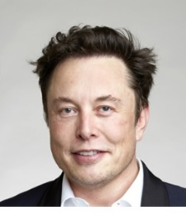
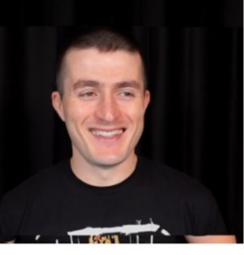
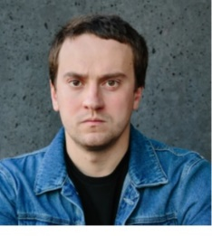
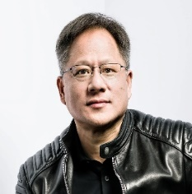
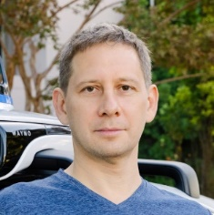
Self-driving
It’s hard, but possible
Many approaches, and techniques
Companies, People
Notes:
Self-driving was initially selected just as a background to try out some machine learning and AI concepts, but it turned out that self-driving is really hard. Harder than I initially thought, and I do not think we are their yet.
Theirs a bunch of companies doing interesting work in this companies and thy use a variety of companies and approaches to try and solve this problem.

Slide 9
Self-driving
Tasks
Lane Lines
Detection
Image Segmentation
Steering
Lateral
Adaptive Cruise Control
Image Classification
Movement
Longitudinal
Road Following
Object Detection
Control
Driving
Computer Vision
Notes:
To try and get a high-level view of how complex self-driving is, lets take a look at some of the common tasks performed while driving:
These tasks range from motion control tasks, like controlling the steering wheel (lateral control), acceleration via brake and gas pedals (longitudinal control), all the way to visual tasks like staying in lane lines.
Staying in lane lines is deceptively complex, not all countries have lane lines, their size and color differ and what do you do if theirs now lane lines. Lane lines can also be obscured by weather (snow).

Slide 10
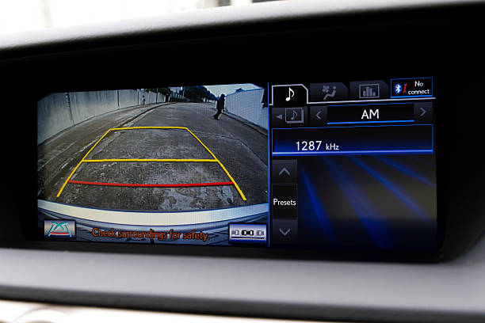
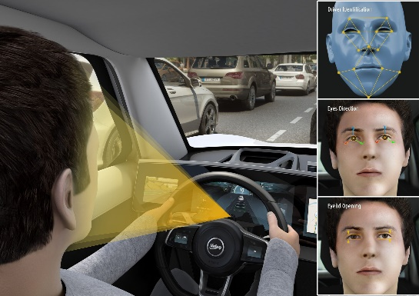


Self-driving
Sensors
Vision: Camera, wide street to driver monitoring
Perception & Localization: What’s around us
Motion: IMU, gyroscopes, and accelerometers
The car: Speedometer, GPS, maps
Notes:
Cars are also equipped with various sensors to help perform these tasks.
One of the key sensors in modern self-driving is vision (or cameras). These cameras can range from narrow or wide views of the road ahead, blind spot or rear cameras and even driver monitoring cameras.

Slide 11
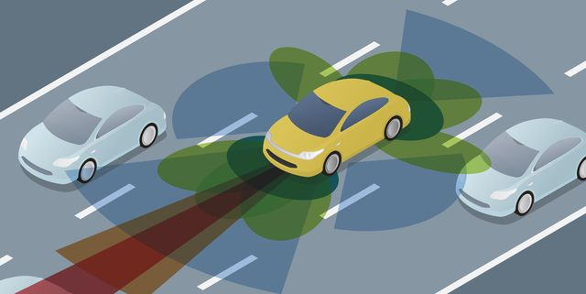
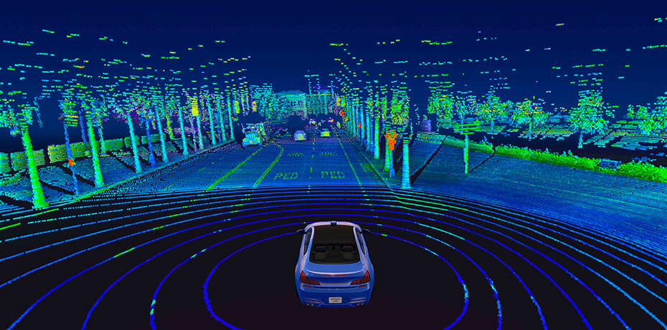
Self-driving
Sensors
Vision: Camera, wide street to driver monitoring
Perception & Localization: What’s around us
Motion: IMU, gyroscopes, and accelerometers
The car: Speedometer, GPS, maps
Notes:
The second set of sensors used is perception and localization sensors. There is currently a debate as to which is better but in general cars either have radar or lidar sensor to understand and localize their surroundings. These sensors typically have short ranges but can build really high definition models of what’s around your car.

Slide 12
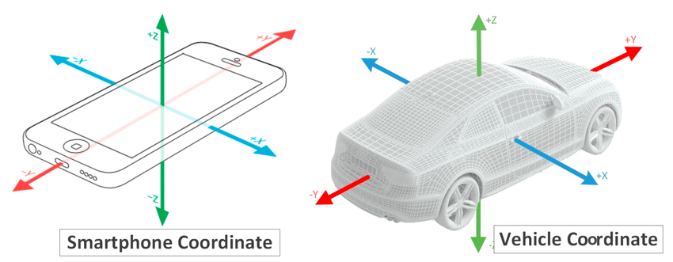
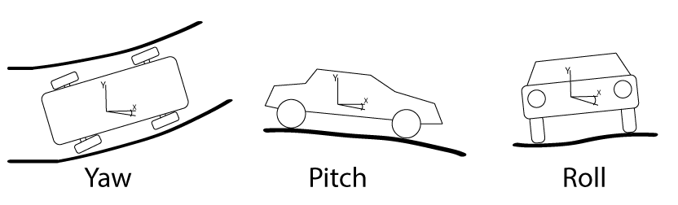
Self-driving
Sensors
Vision: Camera, wide street to driver monitoring
Perception & Localization: What’s around us
Motion: IMU, gyroscopes, and accelerometers
The car: Speedometer, GPS, maps
Notes:
The next set of sensors is all about motion. You can think of these sensors similar to how your phone has sensors to detect if its portrait of landscape. These sensors include accelerometers and gyroscopes to measure immediate acceleration and can even include motion sensors like IMU’s that can return you current orientation, rotation, roll, pitch or yaw. This type of sensor can be used to determine am I currently driving up hill or downhill?

Slide 13
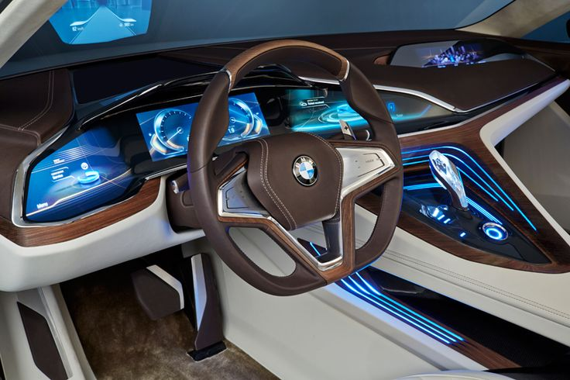
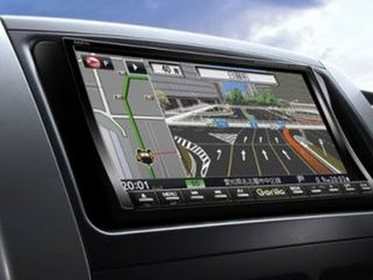
Self-driving
Sensors
Vision: Camera, wide street to driver monitoring
Perception & Localization: What’s around us
Motion: IMU, gyroscopes, and accelerometers
The car: Speedometer, GPS, maps
Notes:
The last set of sensors are included with most cars today. These sensors can typically be accessed via the can bus and include sensors like speedometers (that can tell you how fast you are driving), or even GPS to get your current location and this can be correlated with mapping providers to determine features about your environment like the current speed limit for the stretch of road you are on.

Slide 14
@rudigrobler v1.0.6
SELF-DRIVING cars using GTA and DEEP LEARNING

Slide 15
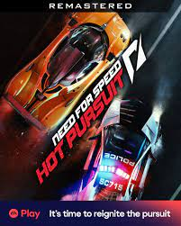


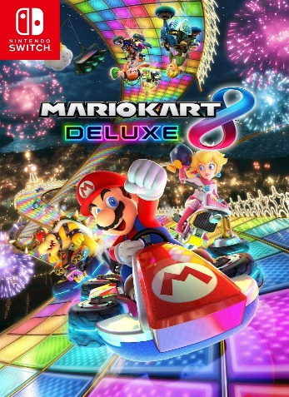


GTA
Could have been ANY game
Notes:
Here GTA is not really the focus!
All I really needed was a road and some sort of car control, which means it could have been as simple as Mario Kart or Fortnite, or more realistic driving games like GT or forza.
There are also cool simulation environments available like Carla.
I’ve selected GTA as my focus!

Slide 16
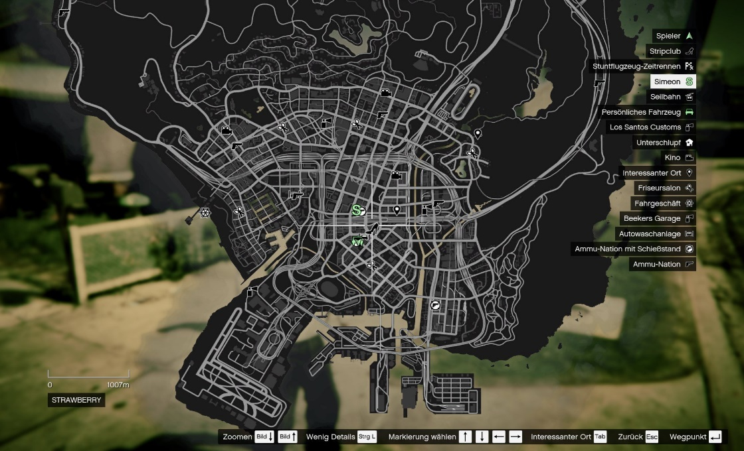
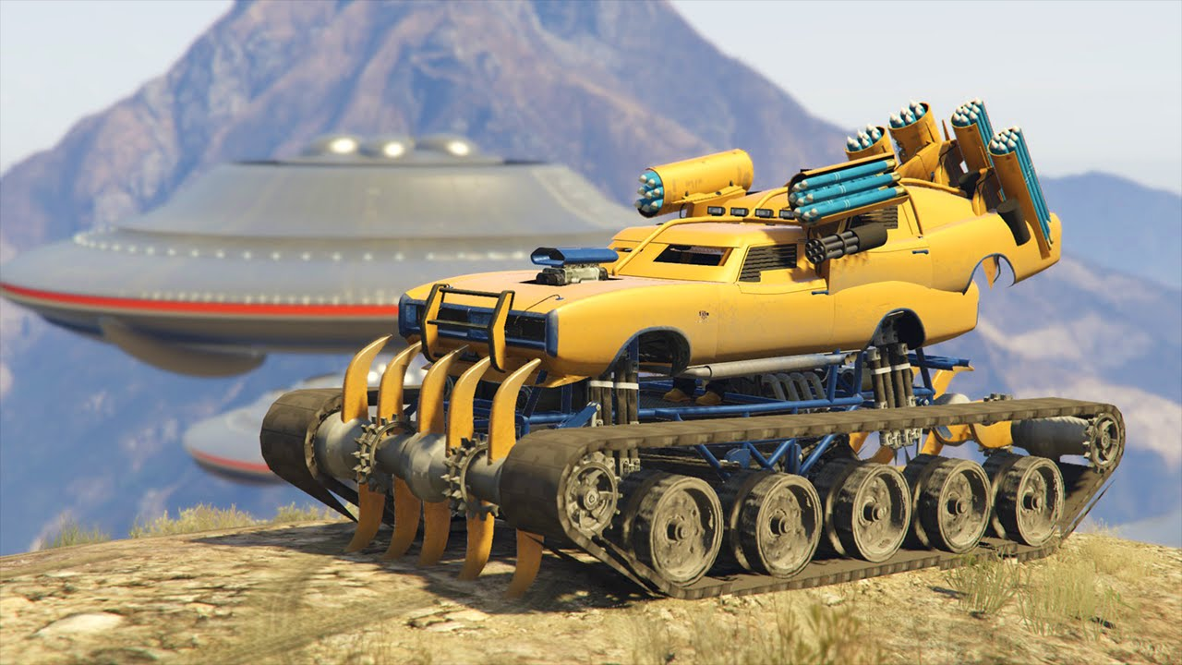
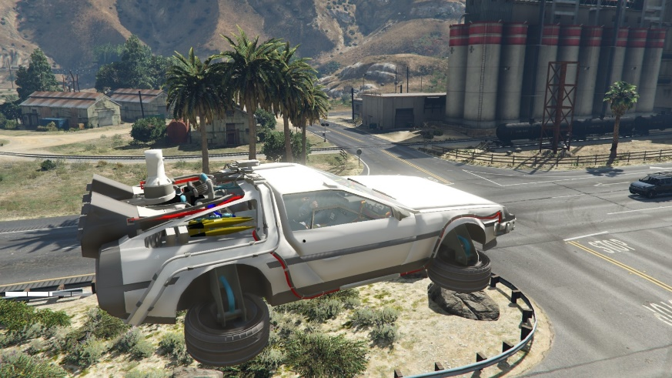
GTA
Why GTA?
Its mod-able
Open world, and realistic
Fewer humans to hit, but…
Fun, fun, fun
Notes:
I’ve selected GTA to use as to simulation environment. I’ve selected is for a bunch of reasons but most of all is probably the fact that GTA is extremely mod-able. Theirs a huge community of mod developers creating a wide range of mods. The big ones I am focused on is the hoodcam mod, which allows me to record the game from the perspective of a camera in the car. GTA is also open world which means we can control various things like time of day, weather, etc.
In the real world, self-driving cost real money and have real risk like killing people! GTA allowing me to drive around with less risk… We can still hit stuff but at least it’s not “that” real!
And above all, GTA is fun!

Slide 17
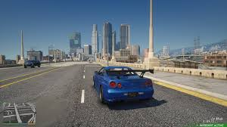

GTA
Screen/Video
Control/Input
+
Trip
\

Slide 18

Demo
@rudigrobler v1.0.5
Screen PUB/SUB

Slide 19
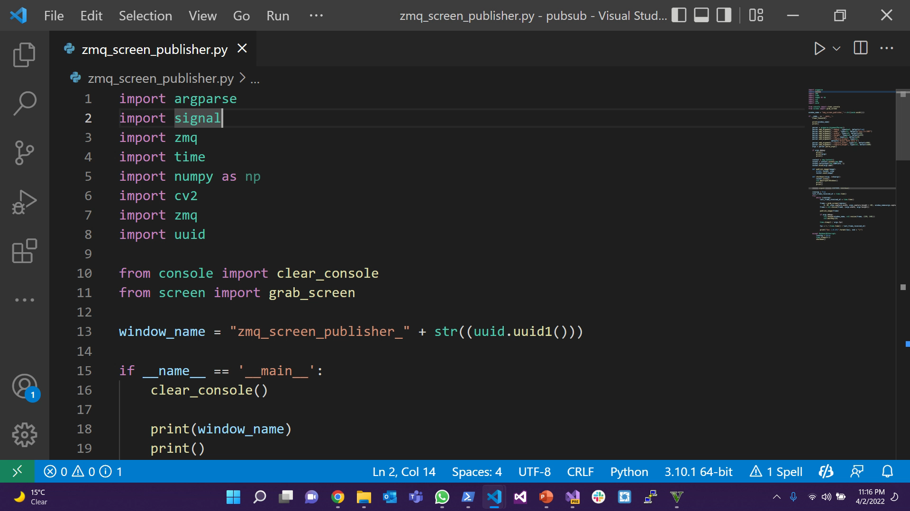

Slide 20
Demo
@rudigrobler v1.0.5
Screen PUB/SUB

Slide 21
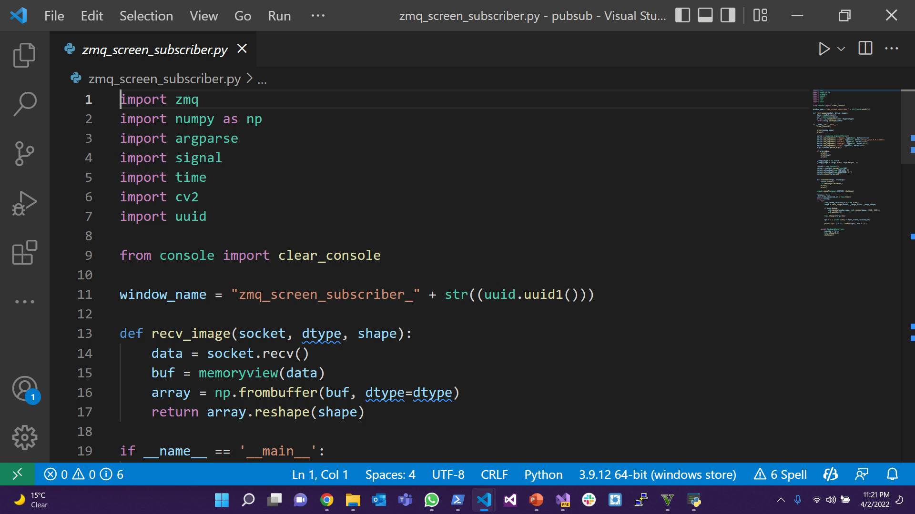

Slide 22
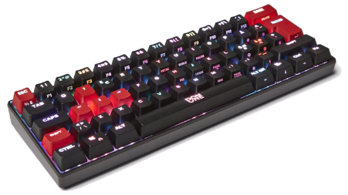
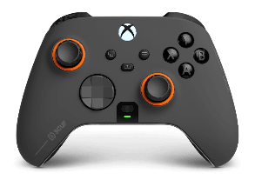
GTA
Screen/Video
Control/Input
+
Trip
\

Slide 23
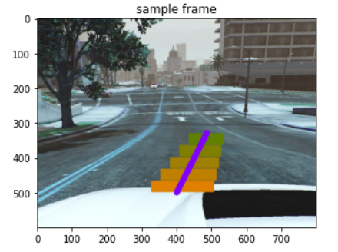
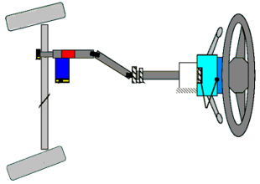
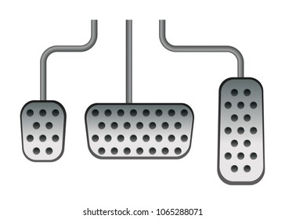
GTA
Just recording control, not enough!
Car State
Speed
Steering Angle
Throttle & Brake
Notes:
I ended up creating a very simple mod, that returns my speed, steering angle, throttle and brake power! These script hooks are extremely each to use and provide you with a ton of information… I could get the 3 key things I wanted to use in training my model, which is steering angle, throttle and brake power.
These plugins can also give you back fuel level, oil level, engine state, etc

Slide 24
GTA
A ScriptHookV script
Car State
Speed
Steering Angle
Throttle & Brake Power
Very flexible and easy, can get back fuel & oil levels. Engine health, rotation, location, and much-much more
Notes:
I ended up creating a very simple mod, that returns my speed, steering angle, throttle and brake power! These script hooks are extremely each to use and provide you with a ton of information… I could get the 3 key things I wanted to use in training my model, which is steering angle, throttle and brake power.
These plugins can also give you back fuel level, oil level, engine state, etc

Slide 25
Demo
@rudigrobler v1.0.5
GTA Car State Script

Slide 26
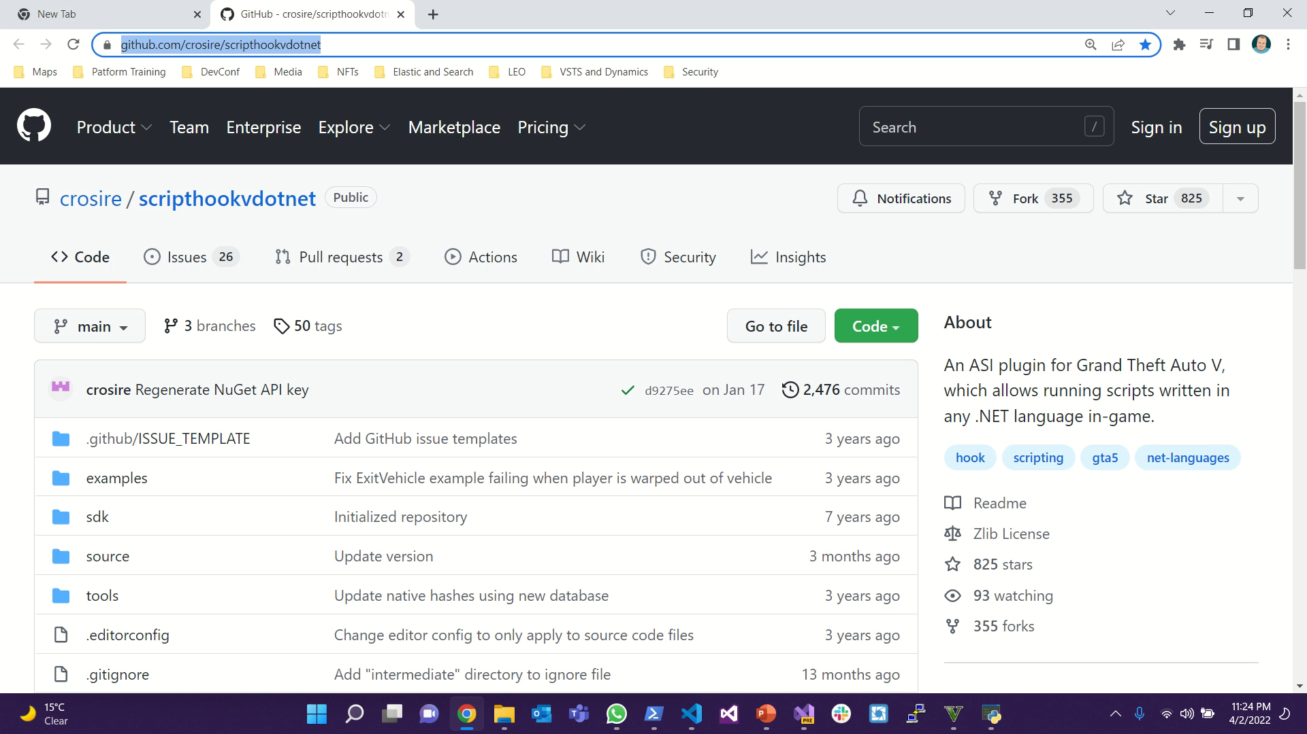

Slide 27
Demo
@rudigrobler v1.0.5
Car State PUB/SUB

Slide 28
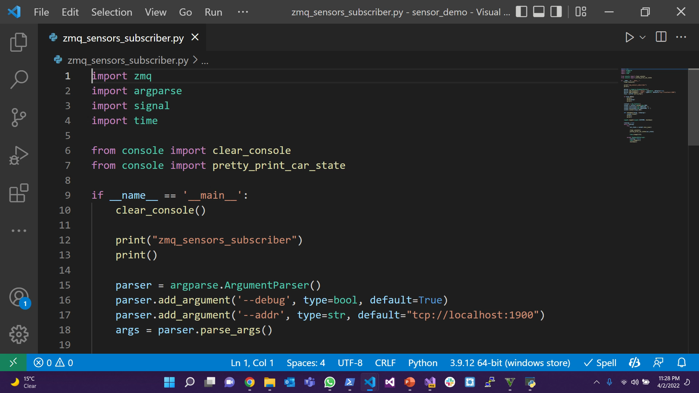

Slide 29
GTA
Screen/Video
Car State
Speed
Steering Angle
Throttle & Brake Power
+
Trip
\

Slide 30
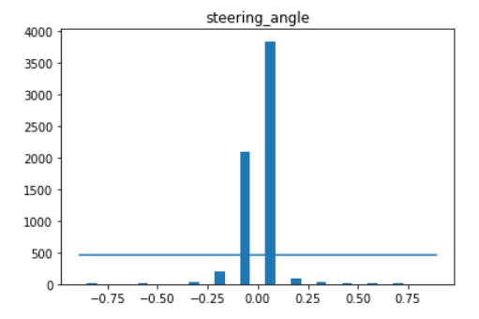
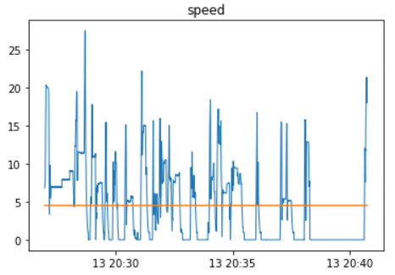
GTA
Trips end to end travelling from point A to point B. Typically 10 minutes of travel, recorded at 7 fps.
Various driving conditions, like day/night, rain or sunshine and time of day
Drivers and cars, various drivers including Franklin, Michael and Trevor (If he is sober) was used..
Segments Each trip gets broken down into 1 min segments to simplify training
Video Each segment has frames (800x600 RGB)
Control Each frame has a correlated car state saved, including the steering angle, power applied to the brake and throttle.

Slide 31
Demo
@rudigrobler v1.0.6
Trip Basics

Slide 32
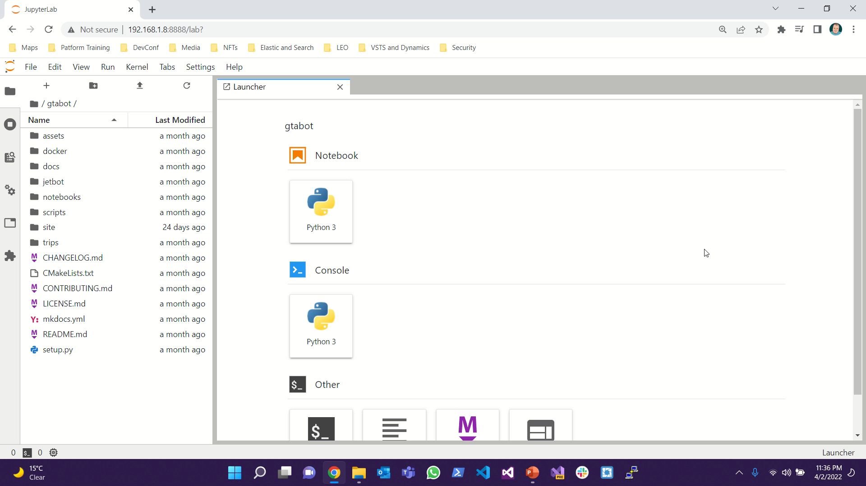

Slide 33
Demo
@rudigrobler v1.0.6
ZMQ Basics

Slide 34
TODO: ZMQ Basics demo

Slide 35
@rudigrobler v1.0.6
SELF-DRIVING cars using GTA and DEEP LEARNING

Slide 36
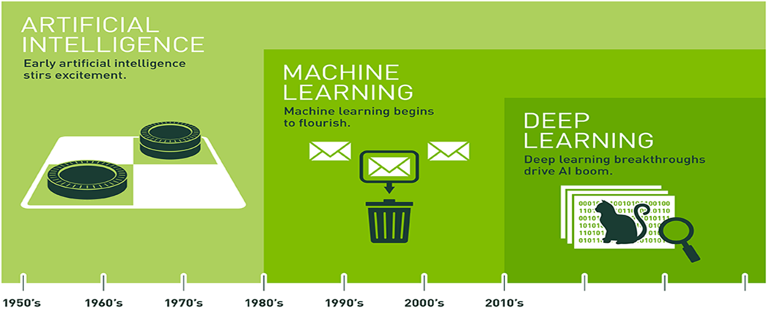
Deep learning
Notes:
I am no AI expert and do not get me tangled up into minute differences between AI, machine learning, etc. But at a very high level, AI is the over arching group of tasks. It evolved into machine learning, which could detect stuff like spam email. This evolved into deep-learning which is these modern competions and demos you see like is it a cat to a dog. Or what break of dog is is

Slide 37
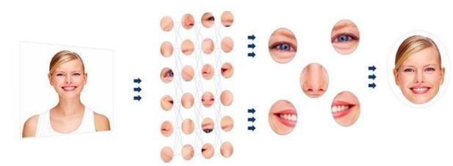



Deep learning
Techniques
Transfer learning
Regression
Imagenet Large Scale Visual Recognition Challenge (ILSVRC)
ResNet
AlexNet
Frameworks, to offload learning to GPU
Notes:
We will be using a technique called transfer learning were we take a pretrained model and try and retrain it to predict our steering angle, throttle and brake power.
Imagenet hosts various AI competitions each year were various academic people compete in building bigger, fast more efficient image models.
We will be reusing a model that won in 2015 called ResNet

Slide 38
Demo
@rudigrobler v1.0.5
Train Model

Slide 39
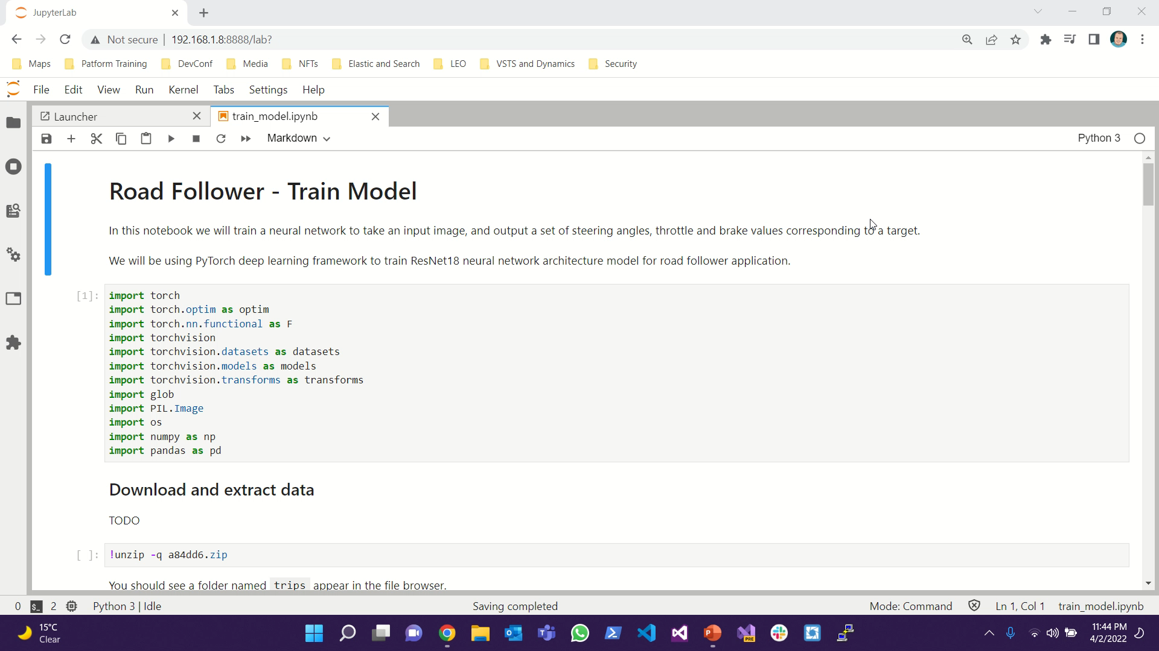

Slide 40
Demo
@rudigrobler v1.0.5
Evaluate Model

Slide 41
TODO: Live demo

Slide 42

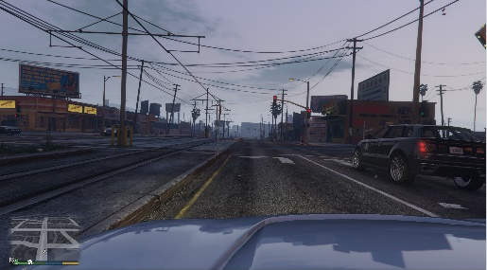
Architecture
Ubuntu (Nvidia Jetson)
Screen Subscriber
Control Client
Car State Subscriber
ZMQ
Windows (Dell)
Screen Publisher
Control Server
Car State Publisher
Notes:
On the windows side, we need to publish the screen and the state of the car
On the nano side, simply subscribe to these messages
At some point, the nano needs to control GTA. For this there is a control server and client that abstracts vjoy to control GTA

Slide 43
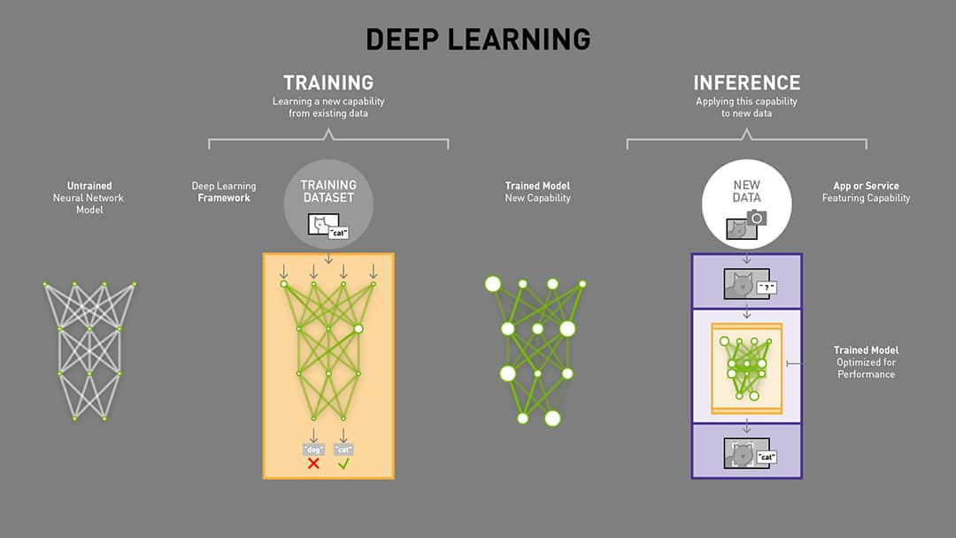
The Plan
COLLECT
training data
TRAIN
our model
EVALUATE
our model

Slide 44
Before we start
Disclaimers, I am not a…
Python developer
AI expert
Gamer
All code and examples will be available to download
Almost all the examples are Jupyter notebooks
Notes:
Disclaimers
I am not a python developer or an AI expert.
All code, samples, training data, etc will be released
Jupyter notebooks will be used

Slide 45
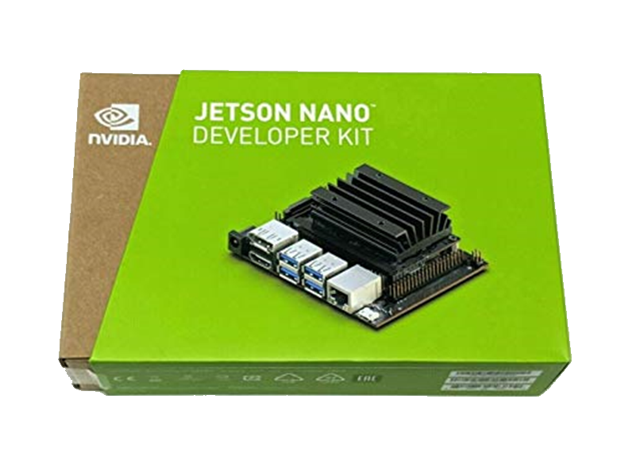
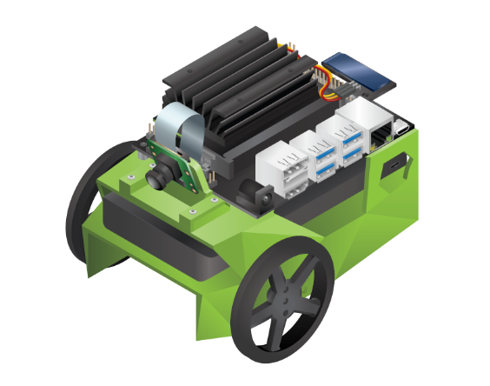
Before we start
Setup
Dell Latitude
Jetson Nano
Based on JetBot
Road following
Object detection
Collision avoidance
Architecture
Distributed (ZMQ)
Over-engineered (sorry)
Notes:
I have a “normal” developer notebook. And as expected, not easy to convince IT to buy me a gamers laptop.
I’ve distributed some of the GPU heavy work to a jetson nano pc. This pc has a 128 core maxwell gpu (128 cuda cores) and 4 cpu’s which means it can train relatively quickly.
Some of my samples is based on the JetBot/JetRacer samples. Thy offer 3D printable robots with really good examples including road following, object detection, etc
Since I am sharing work between my dell pc and the jetson nano, and thy both run different operating systems, I’ve decided to offload all work on ZMQ queues using a combination on pub/sub and req/res services. This abstracts the operating system specific tasks.
It is over engineered!

Slide 46
Summary
Machines can learn what humans can do
Simple pattern
Many other applications like
Fruit sorting and picking
Security systems
Collect
Train
Evaluate
Notes:
Typical machine learning work flow followed
Collect training data
Train model
Test model

